Slide 1

Cancer VARIANT ANALYZER
Tiger Graph Challenge

Slide 2
Problem
Cancer is a leading cause of death worldwide, accounting for nearly 10 million deaths in 2020 (1). The most common in 2020 (in terms of new cases of cancer) were:
breast (2.26 million cases);
lung (2.21 million cases);
colon and rectum (1.93 million cases);
prostate (1.41 million cases);
skin (non-melanoma) (1.20 million cases); and
stomach (1.09 million cases).

Slide 3
Solution
This is a comprehensive Tigergraph database for annotating driver and passenger mutations in terms of Cancer.
The application allows us to view the relationship between gene mutation and cancer.

Slide 4
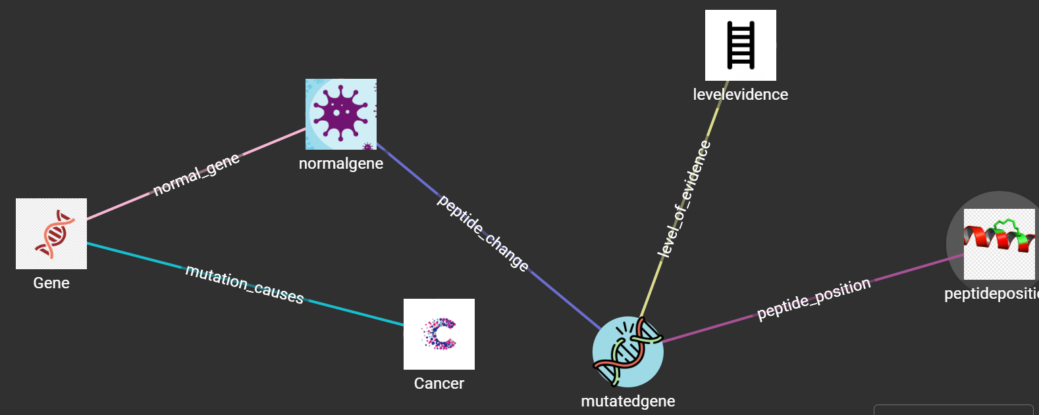
Schema Design:- Dothat graph

Slide 5

CancerVariant Notebook

Slide 6
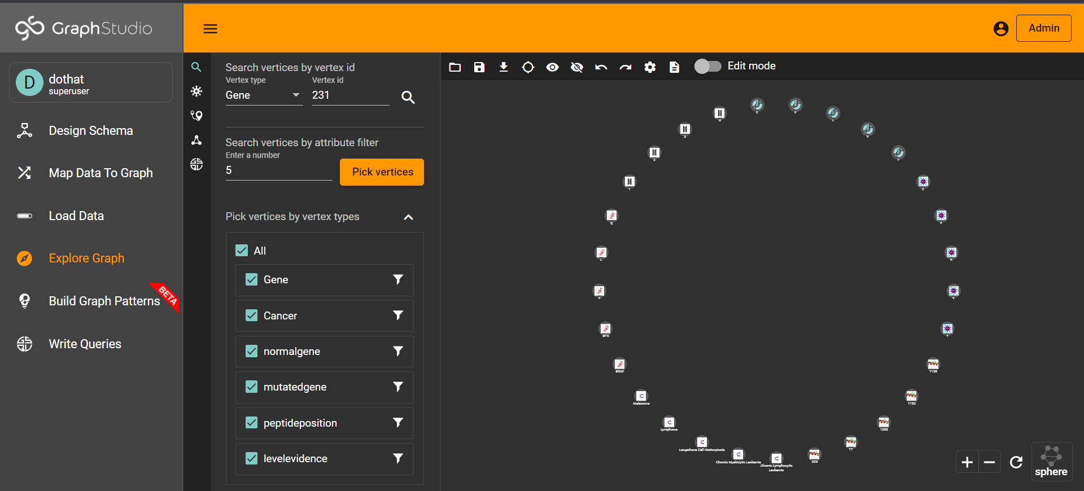
Demo

